Slide 1
Manufacturing Technology 10/04/2018(ME461)
Instructor: Shantanu Bhattacharya

Slide 2
Just in Time Manufacturing Systems
In JIT systems, only the necessary products, at the necessary time, in the necessary quantity are manufactured and stock on hand is held to a minimum.
JIT techniques came out from the Toyota Production system which has the following more aspects apart from JIT:
Process Design
Job design and Standardization
Economic lot sizes
Accelerated setup times
Just in time production
Autonomation
Kanban
Jidoka
Andon
Yo-i-don systems respectively
Toyota Production System: An Overview
The Toyota Production System is a production flow and inventory control system which achieves the following objectives:
Reducing costs by eliminating all kinds of wastes.
Making it easier to achieve and assure product quality.
Attempting to create worksites that respond quickly to change.
Organizing work sites based on human dignity, mutual trust and support etc.

Slide 3
Components of Toyota Production System (TPS)
Autonomation: It is a word that refers to manual or automatic stopping of production in a defective is produced.
Kanban: It is a system of cards used to control work in process, production, and inventory flow.
Jidoka: It refers to a production problem warning system consisting of a battery of yellow and red light called Andon. A yellow light indicates a minor problem or a slight delay. A red light indicates stoppage of production.
Yo-i-don: This refers to a coordinated approach to simultaneous production of parts or subassemblies for assembly into a next stage subassembly.
JIT system: The most distinctive among these is the JIT system and uses the Kanban (meaning visible record) system of tags and cards attached to parts and subassembly containers. The kanban system is an essential tool for managing and controlling the pull type of production inherent in the Toyota Production System.
The problem areas in any production situation that are responsible for higher production costs, low qualityand higher delivery lead time. We need to classify the elements of waste as the3 M’s of muda, mura and muri.
Muda is a Japanese word referring to any work or any element of production that does not add value to the product. In contrast Shigoto refers to the actual work that adds value to the product. In most manufacturing situations the shigoto is relatively small compared with Muda.

Slide 4
Components of Toyota production system
It is very important to eliminate muda. We need to design, plan and control manufacturing system such that the waste is eliminated.
The job attitude of finding out Muda and trying to eliminate this is known as Kaizen.
The following type of Muda’s are avialable:
Muda for correction: The rework process necessary for correcting a defective part means extra costs that should have been avioded in the first place.
Muda for over production: Over production may result from either producing more than necessary or producing at a higher rate than required or both.
Muda for processing: This refers to unnecessary processing work that has no connection to adding value to the product.
Muda in conveyence: Material handling is an important element of production. However, it does not add value to the product and is therefore a kind of Muda.
Muda for inventory: Inventory may be considered a necessary evil. It is necessary because it helps absorb shocks due to uncertainties in supply and acts as insurance against emergencies.
Muda for motion: Any unnecessary movement of workers, materials, or production and material handling equipment that does not add value to the product is a muda of motion.
Muda for waiting: Normally in automated production situations, workers may find themselves idle waiting for the machine to complete its stage of automatic processing

Slide 5
Components of Toyota production system
Mura literally means unevenness. There can be a no. of reasons for unevenness; for example, irregular production volumes, changing work flows, changing production schedules may cause Mura.
Muri essentially means stretching beyond capacity limits, oevrburdening the capacities of people as well as machines. An excessive workload on people beyond their normal capacities leads to safety and quality problems.
A contrast to JIT is being offered by the American companies who are normally based on the materials requirement planning system also known as push system. The work in process inventory is used as a means of absorbing uncertainties in the processes and changes in demand.
In practice however such a system often creates the following problems:
It may lead to starvation and excessive stocks simultaneously at different stages because of imbalances of stocks between the stages.
It may lead to conditions of having excessive equipments and a surplus of workers.

Slide 6
Manufacturing Technology 12/04/2018(ME461)
Instructor: Shantanu Bhattacharya

Slide 7
Pull versus Push System
Push System
Raw Materials
Process 1
Process 2
Process 3
Finished Product
A push system is basically a MRP based production planning and inventory control system. In MRP the master production schedule of end products is transformed into parts requirements.
Work orders are then launched to build the parts in lot sizes using the lot sizing logic of MRP.
The work orders push materials to the manufacturing floor to produce the parts required.
The lot sizes are normally large and consequently production lead times are long.
The parts are pushed to the successive stages as soon as the work is completed at a particular stage.
A problem is created when some parts are not completed and required at successive stages, causing shortages. This phenomena is also referred to as starving the successive stage.
On the other hand there will be too much inventory of some components, causing a blocking of the preceding stage.
Thus we see that the push system is a single flow process in which both the build schedules and materials flow in the same direction from one stage to another.

Slide 8
Pull Versus Push Systems
Pull System
Raw Materials
Process 1
Process 2
Process 3
Finished Product
The transmittal of information distinguishes a pull system from a push system.
In a pull system there is always feedback from the subsequent to preceding stages.
The MPS is only used to give a broad outline of the requirements for resources at different work centers.
The major difference in a pull system is that although the MPS is used for the purpose of deciding approximate resource requirements of workstations, it is not used to determine the production rate of each station.
In a pull system the materials move in the same direction as in the push system but the information concerning processing of parts is given by the subsequent process.
Therefore, the build schedule travel in the direction opposite to the material flow.
A kanban system is used for this purpose.

Slide 9
Types of Kanban
Kanban (in Japanese) means visible record. Toyota developed the Kanban system. The system consists of a set of cards that travel between preceeding and suceeding processes, communicating what parts are needed at the subsequent processes.
The most commonly used Kanbans are the withdrawal kanban and the production kanban.
Withdrawal Kanban:
The primary function of a withdrawal kanban is to pass the authorization for movement of parts from one work center to another.
Once it fetches the parts from the preceding process and moves them to subsequent process, it remains with them till the last part has been consumed by the subsequent process.
Then the withdrawal kanban travels back to the preceding process to fetch parts and the cycle continues.
The withdrawal kanban should have information such as the part number and part name, lot size and routing process to fetch parts and cycle continues.

Slide 10
Withdrawal and Production Kanbans
Part Number
Raw materials and other part types used in manufacturing at the work center
Production Kanban
Container capacity (Number of parts)
Preceding work center no.
Stock Location no.
Part Number
Subsequent work center number
Container capacity (Number of parts)
Stock Location number
Withdrawal Kanban
Preceding work center no.
Number of kanbans released
Stock Location no.

Slide 11
Production Kanban
The main function of a production kanban is to release an order to the preceding process to build parts equal to the lot size specified on the card.
Therefore, the production kanban card should have information on the materials and parts required as inputs at the preceding process in addition to what is present on a withdrawal kanban
Flow of Withdrawal and Production Kanbans and their interactions
Preceding Stage (PPS1)
Subsequent Stage (SPS2)
Stacking Area (SA)
F
P1
F
P2
F
F
F
E
E
P3
E
F

Slide 12
Flow of withdrawal and production Kanbans and their interaction
Let us understand the flow of withdrawal and production kanbans as well as the flow paths of containers.
Consider a simple example of controlling work flow between two preceeding and succeeding processing stages, PPS1 and SPS2, separated by a stacking area (SA).
The sequence of movements of kanbans (both withdrawal and production) are described as follows:
Suppose you start at point P1 in the stacking area. Move the full parts container to the subsequent processing stage, SPS2.
Detach the attached withdrawal card and send it to kanban collection box at point P2. Meanwhile the parts in the container are being used by the subsequent stage.
Once all parts in the container are consumed at SPS2, attach a withdrawal kanban from the kanban collection box to the empty container and move it from SPS2 to location P3 in the stacking area SA.
Now at the P3 location:
Detach the withdrawal kanban from the empty container.
Attach it to a full parts container.
Remove a production kanban from the container to be sent to subsequent stage SPS2.
Send it to processing stage PPS1 to trigger the production of a full container.
5. Put all the parts produced in the empty container and send to stacking area SA with the production kanban attached to it.

Slide 13
Preconditions for operating Kanbans
Kanban is essentially a tool created to manage the workplace effectively. The following are the preconditions for effectively operating the kanban:
Rule 1: No withdrawal of parts without a kanban: We now know that a kanban is a mechanism that controls production on a just in time basis, producing necessary parts in the right quantities at the right time.
Rule 2: The subsequent process comes to withdraw only what is needed: Muda of all types, as discussed, would occur if the preceeding process supplied more parts than are actually needed. This can be avoided only if the succeeding process comes to the preceeding process to withdraw the required number of parts at the time needed.
Rule 3: Do not send the defective parts to the succeeding process: The quality of parts moved by the kanban is the major concern for this rule. Furthermore, defective parts would necessitate work in process inventories besides requiring extra resources of material, equipment and labor.
Rule 4: The preceeding process should produce only the exact quantity of parts withdrawn by the subsequent process: The basic premise behind this rule is to restrict the inventory at the preceeding process to the absolute minimum.
Rule 5: Smoothing of production: Previous rules imply that the subsequent process comes to the preceeding process to withdraw the necessary parts in the necessary quantities at the necessary time.
Rule 6: Fine tuning of production using kanban: Small variations in production requirements are adjusted by (a) stopping the process if the production requirements decrease and (b) Using overtime and improvements in the processes if the production requirements increase.

Slide 14
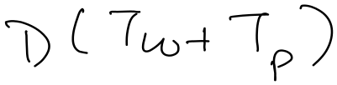








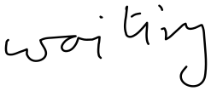






Kanban Planning and Control Models
Kanban is the heart of the JIT system. The number of kanbans plays the most important role in planning, controlling and reducing the work in process inventories. There are deterministic and probabilistic analytical models for determining the optimal number of kanbans.
Deterministic Model:
Let ud first understand how the number of kanbans is determined at a work center in Toyota Motors Company.
Number of kanbans,

Slide 15
Deterministic Model for Kanban
α is a policy variable which is used as a means of managing external disturbances such as changes in demand and variability in processing and delivery times.
D is determined as a smoothed demand.
y is normally fixed even if there are variations in demand.
In that case, when ‘D’ increases the value of the lead time must be reduced accordingly.
Example:
Consider the production of a certain item manufactured in XYZ company. Its requirements are 10,000 units per month. Suppose the company has just started implementing the JIT system. Accordingly, the policy variable is set at α = 0.40. The container capacity is fixed at 50 items and the production lead time is 0.50 days.
Determine the no. of production kanbans.
Suppose the company has stable production environment and the policy variable can be fixed at α = 0.00. Determine the number of kanbans and the resulting impact on work in process inventory.
What happens if the lead time is increased to 1 day because of labor shortages and failure of machines?
What happens if the lead time is reduced to .25 days because of process improvements? The value of α is 0.30 as a result of these process improvements.

Slide 16





































Slide 17



























Slide 18












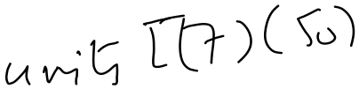










Slide 19




























Slide 20
Manufacturing Technology 13/04/2018(ME461)
Instructor: Shantanu Bhattacharya

Slide 21
In the following example, we analyze a two stage system involving manufacturing at the preceding stage and assembly at the subsequent stage.
Example:
Consider the manufacture of product Z in a company. Product Z is assembled from two parts, X and Y, that are manufactured in the company. A schematic layout depicting preceding stage, staging area, subsequent stage and the flow of production and withdrawal kanbans is given in the next figure

Slide 22
Deterministic approach to kanban size
Succeeding Processes
Preceeding Processes
PK-X
WK-X
Work Center X
SA-X
Assembly Center Z
PK-Y
WK-Y
Work Center Y
SA-Y
Determine the production and withdrawal kanbans.
Now suppose the assembly process is shifted to Mexico as a part of a reorganization. The lead time to travel between the new location in Mexico and the present plant location is 4 days each for X and Y. Determine the no. of production and withdrawal kanbans and the impact of this policy on the work in process inventory.
PK-X = production kanban for part X
PK-Y = production kanban for part Y
WK-X = withdrawal kanban for part X
WK-Y = withdrawal kanban for part Y
SA-X = staging area for part X
SA-Y = staging area for part Y

Slide 23


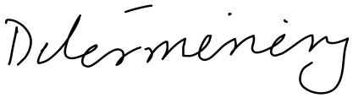






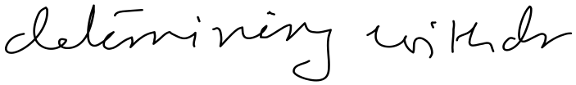










The data for the problem is given below.
part | Demand (units/day) | Lead time (days) | α | Container capacity
Assembly Stage
X | 2000 | 1.0 | 0.00 | 100
Y | 800 | 0.5 | 0.25 | 50
Manufacturing Stage
X | 2000 | 0.50 | 0.20 | 100
Y | 800 | 1.00 | 0.00 | 50

Slide 24
















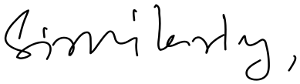

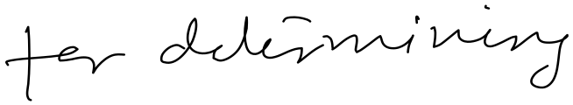



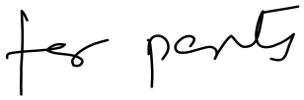



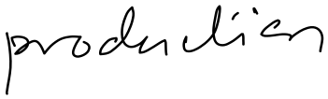





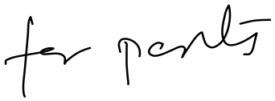



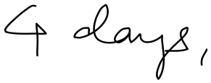


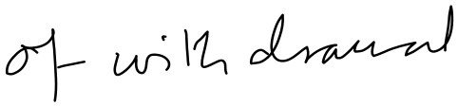








Slide 25
Example Problem
Johnson and Johnson, a private company, supplies parts to a spark plug manufacturing company, JJ is now planning to introduce JIT production concepts for their shell manufacturing section. The following data are avialable: The requirements are 25,000,000 units per month. Since the company has just started implementing the JIT system, the policy variable is set at α =0.20. The container capacity is fixed at 500 shells and the production lead time is 0.10 days.
(a)Since it is the first time that JJ is implementing JIT, advise JJ in developing a kanban operating system. How many kanbans will be needed?
(b) Suppose the company has stable production environment and the policy variable can be fixed at α =0.10. Determine the no. of Kanbans and the resulting impact on work-in-process inventory.
(c) What happens if the lead time is reduced to 0.08 days because of process improvements?

Slide 26





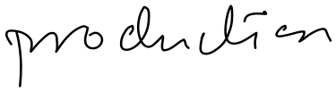

Probabilistic cost model for determining optimal number of Kanban:
Typically in a JIT operation the master production schedule is frozen for 1 month and the no. of Kanbans in each working center is set based on average demand for the period.
In this section we develop a cost model considering the expected cost of holding and shortages.
It is assumed that the probability mass function (PMF) of the number of kanbans required is known.
Let us assume the following notations:
P(x) = probability mass function for the number of kanbans required
C_{h} = holding cost per container per unit time at a work center
C_{s} = cost of a shortage per container per unit time at a work center
Suppose there are ‘n’ kanbans circulating in the system.

Slide 27








Case 1:
The actual requirement for the kanbans, x, is less than ‘n’. In that case holding cost will be incurred. Accordingly,
Expected holding cost = C_{h} Σ(n-x) p(x)
Case 2:
The actual requirement for the kanbans, x is more than n. In that case shortage costs will be incurred. Accordingly,
Expected shortage cost = C_{s} Σ(x-n) p(x)
Therefore, the total expected cost, TC (n) is given by:
TC (n) = C_{h} Σ(n-x) p(x) + C_{s} Σ(x-n) p(x)
The optimal value of n that gives the minimum value of TC (n) is the smallest integer satisfying the following:

Slide 28
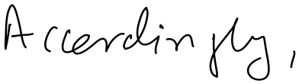





















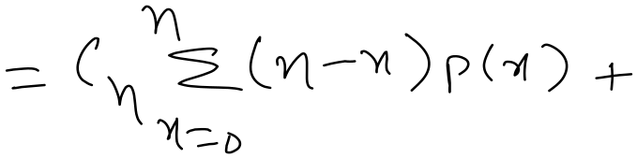



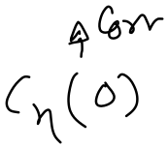













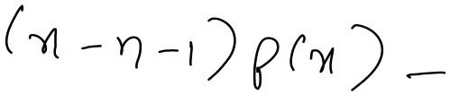

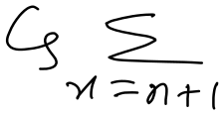




Slide 29













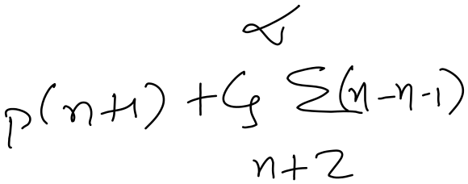


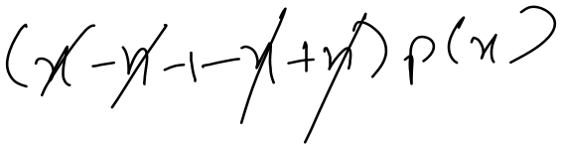
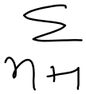



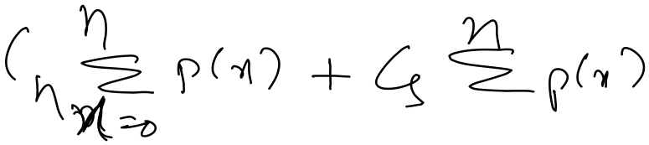

Slide 30









Slide 31


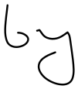
Example :
Suppose that the probability mass function of the number of kanbans is known and is given in the table ahead. Furthermore, suppose the holding and the shortage costs per unit time are $50 and $200, respectively. Determine the optimum number of kanbans to minimize the total expected cost.

Slide 32
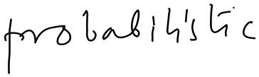
Probability | 0.00 | 0.20 | 0.30 | 0.35 | 0.10 | 0.05
No. of kanbans | 0 | 1 | 2 | 3 | 4 | 5
Relationship between JIT manufacturing, setup time, and cost:
JIT manufacturing is often understood to mean a manufacturing system with lot size approaching unity. It is important to understand the conditions under which this goal may be achieved. The answer may come directly from the classical economic production quantity inventory model.
In a JIT manufacturing environment the intent is not to permit shortages. Accordingly, the total variable cost consisting of setup and holding as a function of economic production quantity Q, is given by

Slide 33


Slide 34


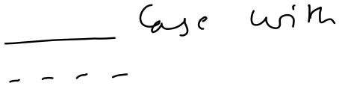




Slide 35
Manufacturing Technology 17/04/2018(ME461)
Instructor: Shantanu Bhattacharya

Slide 36




Example:
Consider a product with the following data:
Unit Cost, C = $100.00
Annual inventory carrying cost rate, i= 10%
Demand rate, D = 10,000 units/ year
Production rate, P = 15,000 units/ year.
Determine the optimal lot sizes for various values of setup costs varying from $400.00 to $0.00016.

Slide 37
Signal Kanban:
One of the important conditions for the implementation of JIT with kanbans is to have low setup times relative to processing times. However, there are situations in manufacturing companies, such as forging, die casting, and press operations, in which the setup time is not small relative to processing time.
The standard Kanban approach as discussed earlier does not work under these circumstances. We use a special type of Kanban known as a signal Kanban at the work centers with large setup times.

Slide 38
Signal Kanban
In effect a Signal Kanban triggers the production of a lot that consists of more than one container at these work centers with large setup times.
However, standard Kanbans at normal work centers concurrently triggers the production of one container at a time.
Normally, there are two types of signal kanbans. The first is rectangular and is known as raw material ordering kanban. It is used to withdraw materials from the preceeding stage.
The other type is known as the production ordering kanban, is triangular and is used to trigger production of a container.
In a normal Kanban process , when a withdrawal is made, a production kanban is sent back to the preceding stage to trigger the production of 1 container.
In a signal Kanban system the production Kanban is not sent back to the preceding stage after every withdrawal of a container to the succeeding station.
A triangular production ordering signal kanban is attached at the reorder point of the lot.
This triangular kanban initiates the setup process to produce the whole lot at the signal kanban work center as soon as the container to which it is attached is withdrawn by the succeeding stage.

Slide 39
Position of raw material ordering signal kanban
Raw Material Inventory stage
Lot Size
Work Center
Position of production ordering signal kanban
B
A
Material Signal Kanban
A: Signal Kanban receiving post
B: Signal Kanban ordering post
Production Signal Kanban

Slide 40
Signal Kanban
In addition to the production ordering kanban, a rectangular material ordering kanban may also be attached to the lot to order material from storage.
As soon as the container with a material kanban is withdrawn, the material signal kanban is sent to the preceding stage to withdraw the required items.
These items will be needed at the work center to process the entire lot.
When raw material reaches the workcenter the production ordering signal kanban may not be there already to trigger the production.
However, the raw material will be waiting the arrival of the production signal kanban card to initiate the production setup for the lot.
Normally, the triangular kanban is attached to the next container of the lot after attaching the Material signal kanban.
There are two important aspects of a signal Kanban system:
The determination of lot size.
The position of both production ordering and material ordering signal kanbans.

Slide 41
Example of signal kanban:
Consider an automotive company that manufactures three types of die casting products at a die-casting station. Suppose the factory operates on two shifts. The die-casting machine is utilized at 80% of its capacity of producing parts, leaving 20% operating time for setup.
Over a period of two shift, the time available for setups = 3.2 hours (2X 8 hr./ shift X 20%).
Suppose the average setup time is 32 mins. A maximum of two setups per part is possible. (3.2 X60/32X1/3).
If the demand of the part is 1400 per day with α= 20 %, the minimal lot size of the part can be calculated as follows:
Minimal lot size per setup = ½ X 1400 X120% = 840.
If the container capacity is 100 parts. We then need 840/100 = 8.4 ~ 9 containers.
Let us now determine the position of the production ordering signal kanban in the lot of 9 containers.
The position is determined by the consumption of parts during the time interval from the point of ordering the lot to the arrival of the lot to its stock location.

Slide 42
Example of signal kanban:
This time interval is also known as Kanban Cycle Time.
As such Kanban Cycle Time = Kanban waiting time at the receiving post + its transfer time to the ordering post + its waiting time in the ordering post + lot processing time + container transfer time to final buffer.
The following formulae can be used to determine the production kanban position in terms of number of containers.
Production signal kanban position = (Average demand) (1+α) (Kanban cycle time)
(Number of parts per container)
Suppose the Kanban lead time is 3 hrs. This is equivalent to 3/16 days based on two shifts of 8hrs each.
Production signal kanban position= 1400 (1.20)(3/16) = 3.15 ~ 4 containers
100
Similarly we can determine the position of the material ordering signal kanban. The components of cycle time are the following:
Material Ordering signal kanban = waiting time at the receiving post + transfer time to raw material storage + waiting as well as withdrawal time at the raw material storage + material transfer time to the work center + lot processing time + container transfer time to final buffer.

Slide 43
Example of Signal Kanban:
Notice that lot processing time and container transfer time to final buffer are common to both production and material signal kanbans.
Very often the material ordering signal kanban cycle time is greater than the production ordering signal kanban cycle time. Suppose the material ordering signal kanban cycle time is 4 hours.
Material ordering signal kanban position = (1400 X 1.2 X 4/16) = 4.2 ~ 5 containers.
100
Other types of signal kanbans:
So far we have seen production and conveyence kanbans. However, other types of kanbans are used in specific situations as follows:
Express Kanban :
An express kanban is used when there is a shortage of parts. It must be withdrawn after its use. The presence of an express kanban in a red post triggers the following activities:
A button for the machining line making the part is switched on, activating a red light on the light board known as andon for the part.
The worker at the location where the light has come on must immediately produce the part and deliver it personally to the subsequent process.

Slide 44
Emergency Kanban:
This kanban is used as a temporary measure to make up for the defective units and other uncertainities such as machine failures or fluctuations in daily or weekly production.
Through Kanban:
In production situations in which two or more work centers are located close to each other, there is no need to exchange production and conveyence kanbans between these work-centers.
Alternative JIT systems:
Though JIT is usually understood as a pull system in which the amount of material flow at the immediately preceding station is determined by the stock consumption at the subsequent station, there are a no. of alternative methods for JIT production. These are :
(1)Periodic Pull System : In a periodic pull system is one in which the manual information processing time of a kanban method was replaced by an online computerized processing.
(2) Constant Work in Process System : In this system in contrast to kanban cards, which are part no. specific, the CONWIP cards are assigned to the entire production line. The advantage of this system over the kanban system is that it can be used in environments where the kanban system is impractical because of a large no. of part types.
(3)Long Pull System: In the long pull system, the triggering mechanism works in the same way as in a pull system. However, the control of the long pull encompasses more than one workstation. In this system one unit is allowed to enter the system at the same time that one unit is pulled at the end of the pull.

Slide 45
Total Quality Control and JIT:
Total quality control is really “total” in the sense that it pervades all departments of a manufacturing company as well as the supplier company.
TQC means an integrated approach to sharing responsibility for quality production of products; it requires a commitment from every individual from all functional departments in the company to achieve the goal of quality production.
Because defects are not permitted in the JIT production system, it is important to have a TQC program for the successful implementation of JIT production in the company.

Slide 46
Manufacturing Technology 19/04/2018(ME461)
Instructor: Shantanu Bhattacharya

Slide 47
Concurrent Engineering
In concurrent engineering approaches two concepts are very important.
1. All elements of product lifecycle- from functionality, production, assembly, testing,

Slide 48
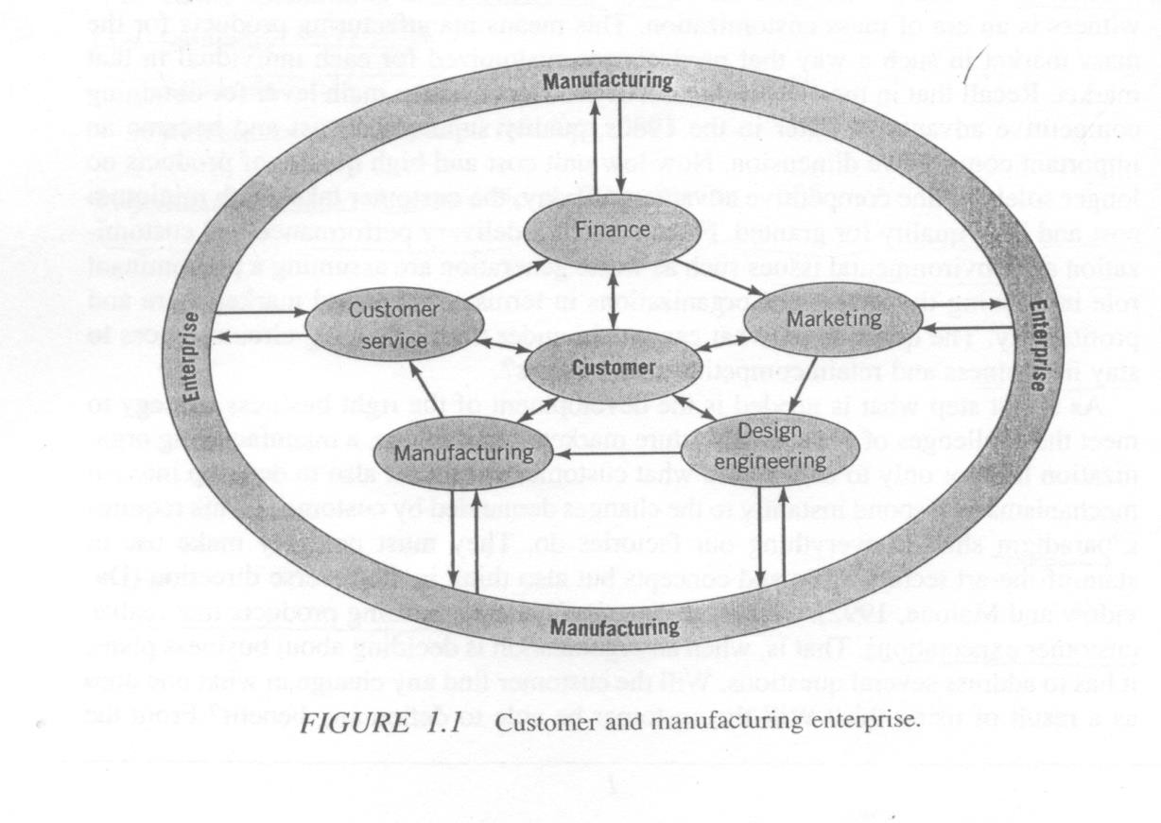
Current Organizational Structures

Slide 49
What is concurrent engineering?
Concurrent engineering is a systematic approach to the integrated, concurrent design of products and their related processes, including manufacture and support. This approach is intended to cause the developers from the outset, to consider all elements of the product life cycle from conception to disposal, including quality, cost, schedule, and user requirements.

Slide 50
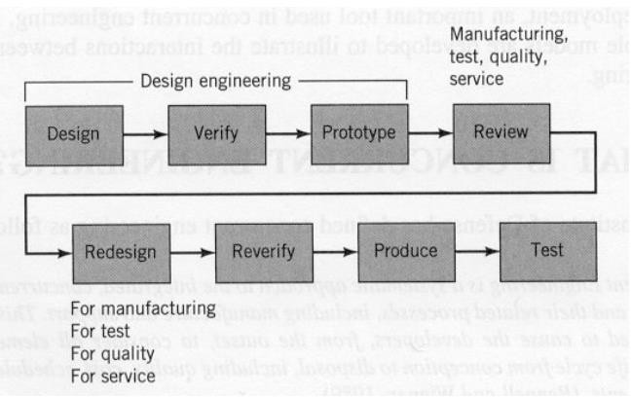
Serial or Sequential Engineering
Flow Diagram of the Sequential engineering
Sequential Engineering is characterized by departments supplying information to design only after a product has been designed, verified, and prototyped.

Slide 51
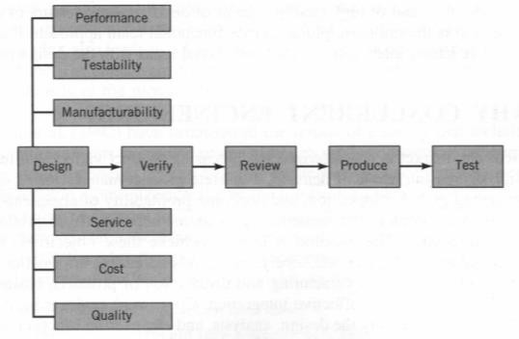
In Concurrent the
engineering all
are
Flow Diagram of the concurrent
engineering
functional
areas
integrated with process.
The information
the design
flow is
interlinked with various phases in concurrent engineering.
Multidirectional exchange of information takes place.
The integration
of other
functional areas with the design process helps discover hard to solve problems at the design stage

Slide 52
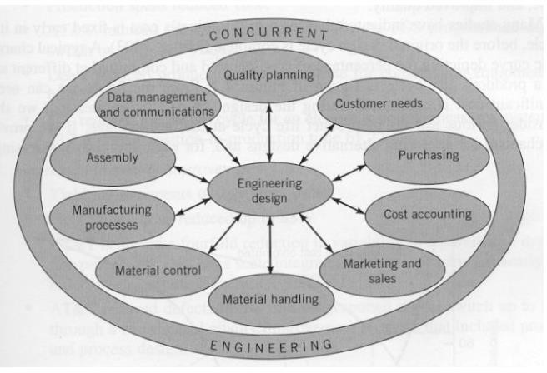
Multidisciplinary, Cross functional team for design in a concurrent engineering environment

Slide 53
Why concurrent engineering?
Increasing product variety and technical complexity that prolong the product development process and make it more difficult to predict the impact of design decisions on the functionality and performance of the final product.
Increasing global competitive pressure that results from the emerging concept of reengineering.
The need for rapid response to fast-changing consumer demand.
The need for shorter product life cycle.
Large organizations with several departments working on developing numerous products at the same time.
New and innovative technologies emerging at a very high rate, thus causing the new product to be technological obsolete within a short period.

Slide 54
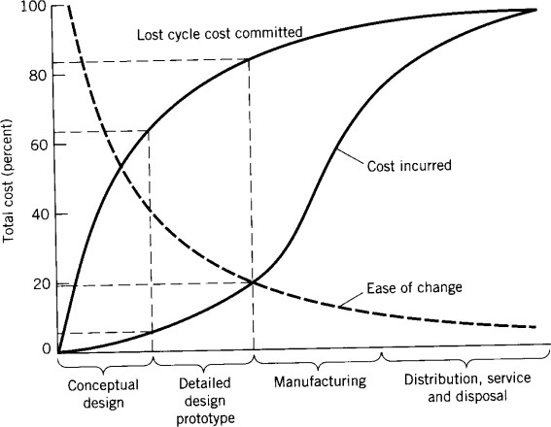
A characteristic curve representing cost incurred and committed during the
product life cycle

Slide 55
Results of a survey that include the following improvements to specific product lines by the applications of concurrent engineering
1. Development and production lead times
Product development time reduced up to 60%.
Production spans reduced 10%.
AT&T reduced the total process time for the ESS programmed digital switch by 46% in 3 years.
Deere reduced product development time for construction equipment by 60%.
ITT reduced the design cycle for an electronic countermeasures system by 33% and its
transition-to-production time by 22%.
2. Measurable quality improvements
Yield improvements of up to four times.
Field failure rates reduced up to 83%.
AT&T achieved a fourfold reduction in variability in a polysilicon deposition process for very large scale integrated circuits and achieved nearly two orders of magnitude reduction in surface defects.
AT&T reduced defects in the ESS programmed digital switch up to 87% through a coordinated quality improvement program that included product and process design.
Deere reduced the number of inspectors by two-thirds through emphasis on process control and linking the design and manufacturing processes.

Slide 56
3. Engineering process improvements
Engineering changes per drawing reduced up to 15 times.
Early production engineering changes reduced by 15%.
Inventory items stocked reduced up to 60%.
Engineering prototype builds reduced up to three times.
Scrap and rework reduced up to 87%.
4. Cost reduction
McDonnell Douglas had a 60% reduction in life-cycle cost and 40%
reduction in production cost on a short-range missile proposal.
Boeing reduced a bid on a mobile missile launcher and realized costs 30 to 40% below the bid.
IBM reduced direct costs in system assembly by 50%.
ITT saved 25% in ferrite core bonding production costs

Slide 57
Example for Serial Engineering vs. Concurrent Engineering:
Case Study I
ABC Company requires 1000 units of a turned cylindrical part (shaft). The design department of ABC company defines a need for a cylindrical part to be finished to 1±0.003 inch. A serial engineering approach and a concurrent engineering solution are presented in the two scenarios that follow. We compare two situations that emerge from these strategies.
Serial Engineering Approach
The design department of ABC recommends a shaft dimension and tolerance of 1±0.003 inch; this information is transmitted to the manufacturing engineering department.
In the serial engineering approach, manufacturing engineering accepts these specifications and attempts to find the best manufacturing technology to accommodate the request made by design.
Manufacturing engineering will challenge the specification only if the design is not producible.
Drawing on the preceding analysis, manufacturing engineering decides to produce the parts on a turret lathe because the desired tolerances can be obtained. The process average and the standard deviation are estimated to be 1.00 and 0.003 inch, respectively.

Slide 58
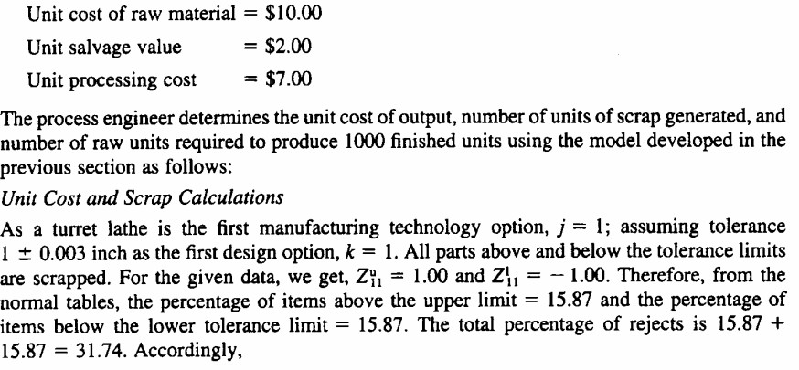

Slide 59
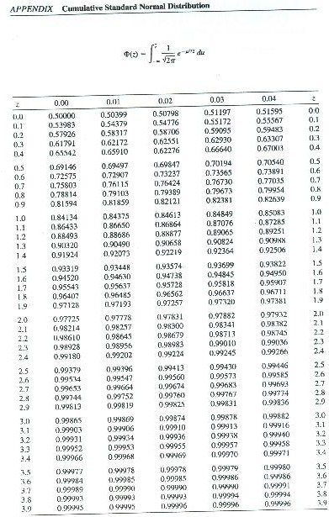
Normal Distribution Charts

Slide 60
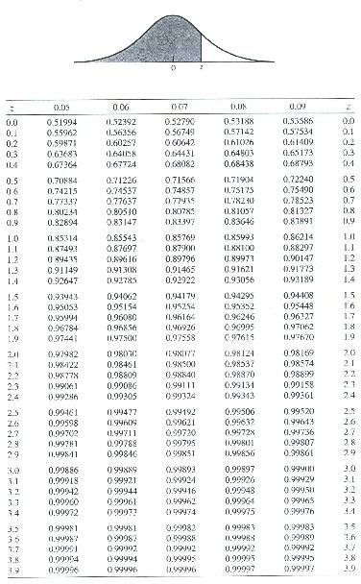
Normal Distribution Chart

Slide 61
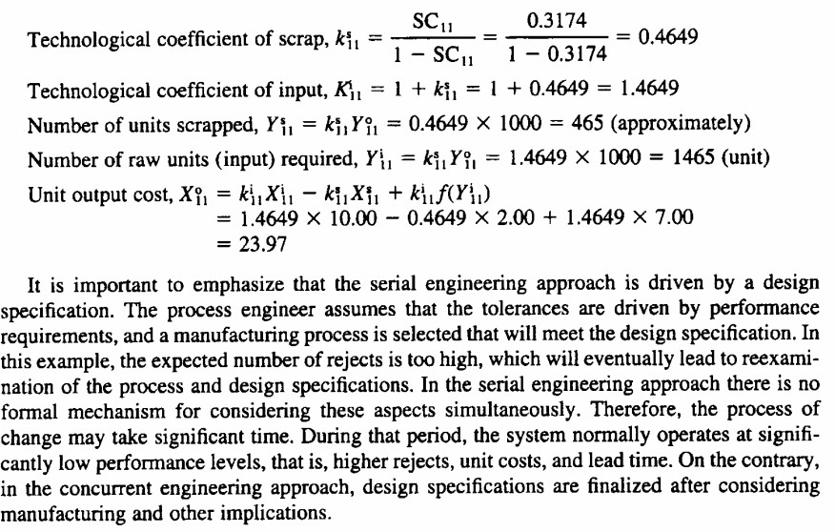

Slide 62
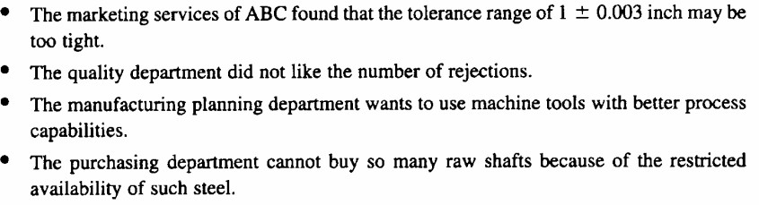
Concurrent Engineering Approach
Various issues to be addressed by multidisciplinary team:

Slide 63
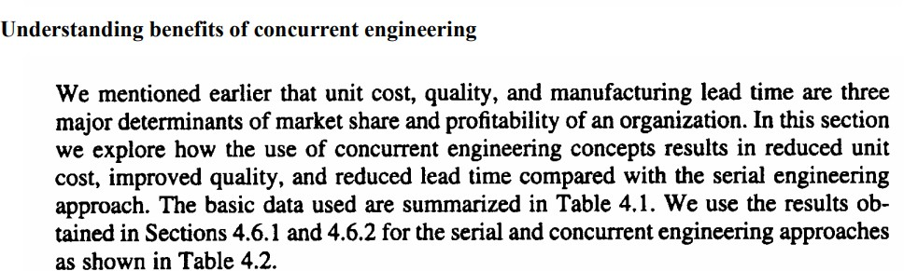
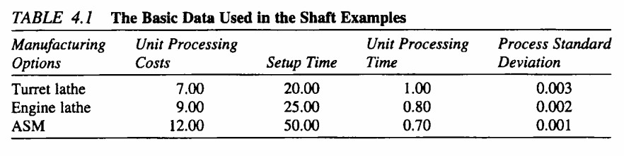

Slide 64
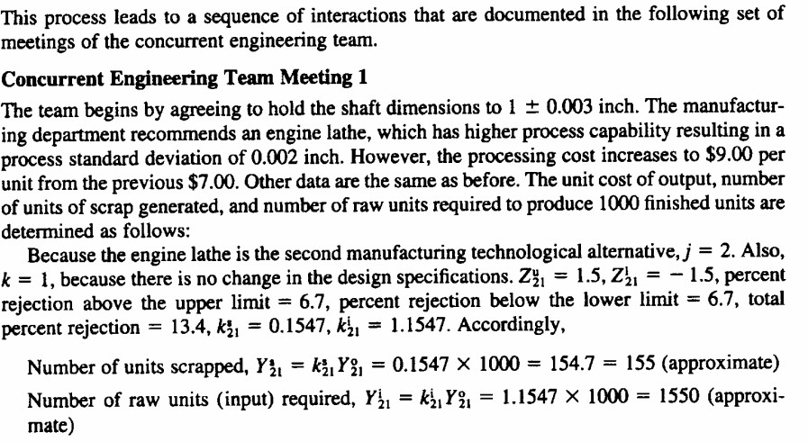


Slide 65
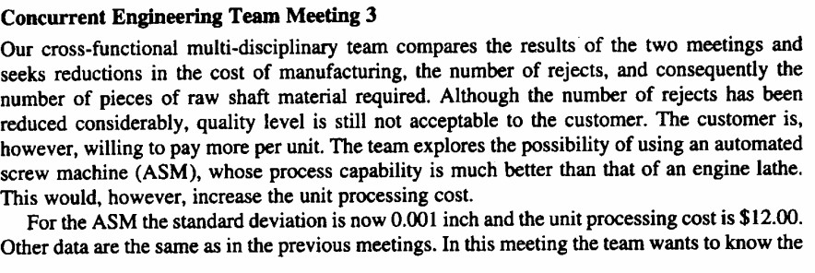
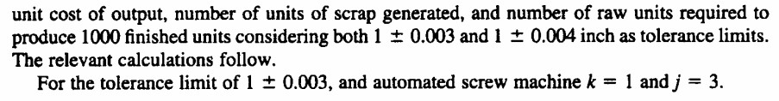

Slide 66
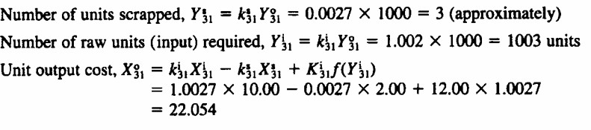
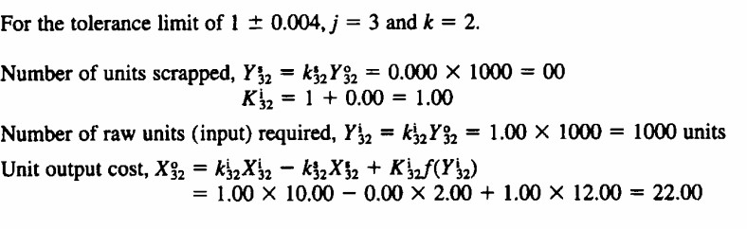

Slide 67
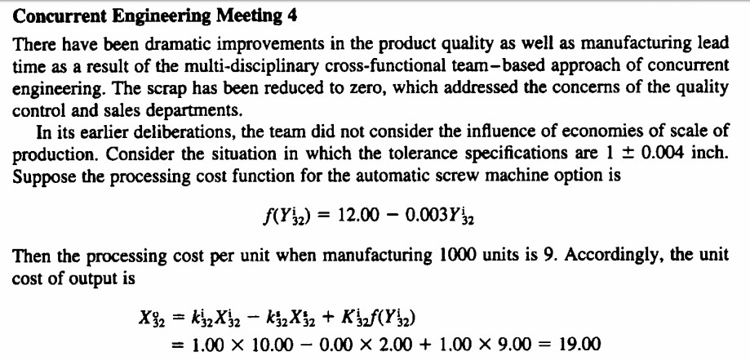

Slide 68
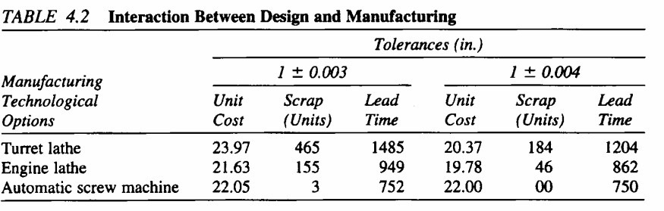
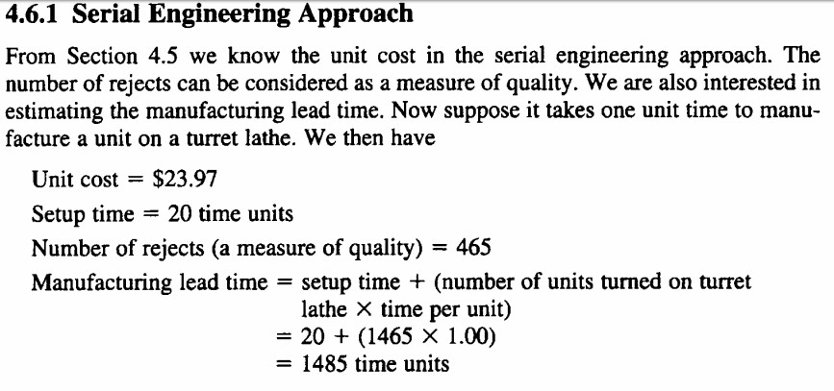

Slide 69
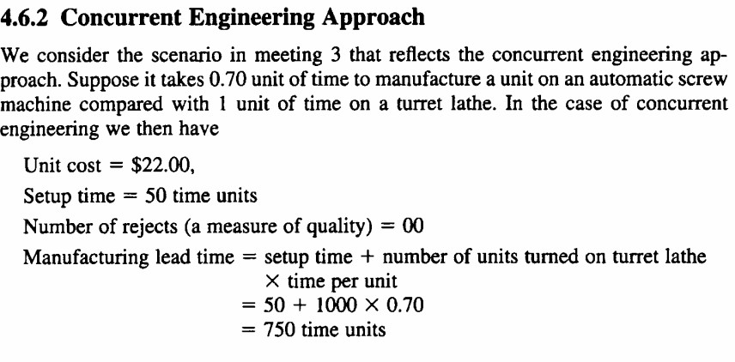

Slide 70
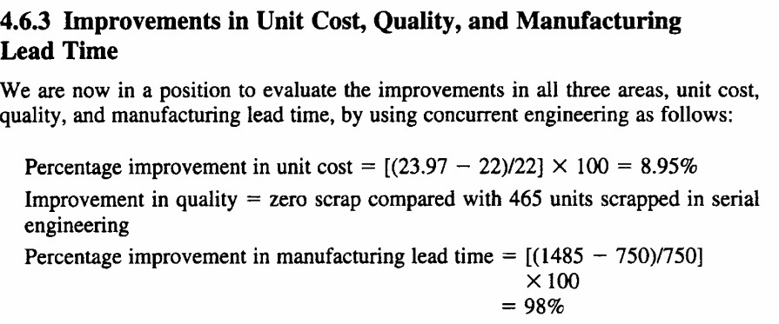
[(1485-750)/1485]X100
49.50%
Case study II: For the Journal and Bearing combination is provided to you already as home assignment.

